Slide 1

API Docs with OpenAPI 3.0
An Introduction + Hands-on Workshop

Slide 2
What is an API? And a Web API?
API stands for Application Programming Interface
APIs provide ways for software to communicate with other software
A Web API is an API whose endpoints are exposed to the web
Want to explore? More than 23k web APIs are listed at
https://www.programmableweb.com/apis/directory
Howdy! My name’s Soundwave, and I’m an API.
Sort of.

Slide 3
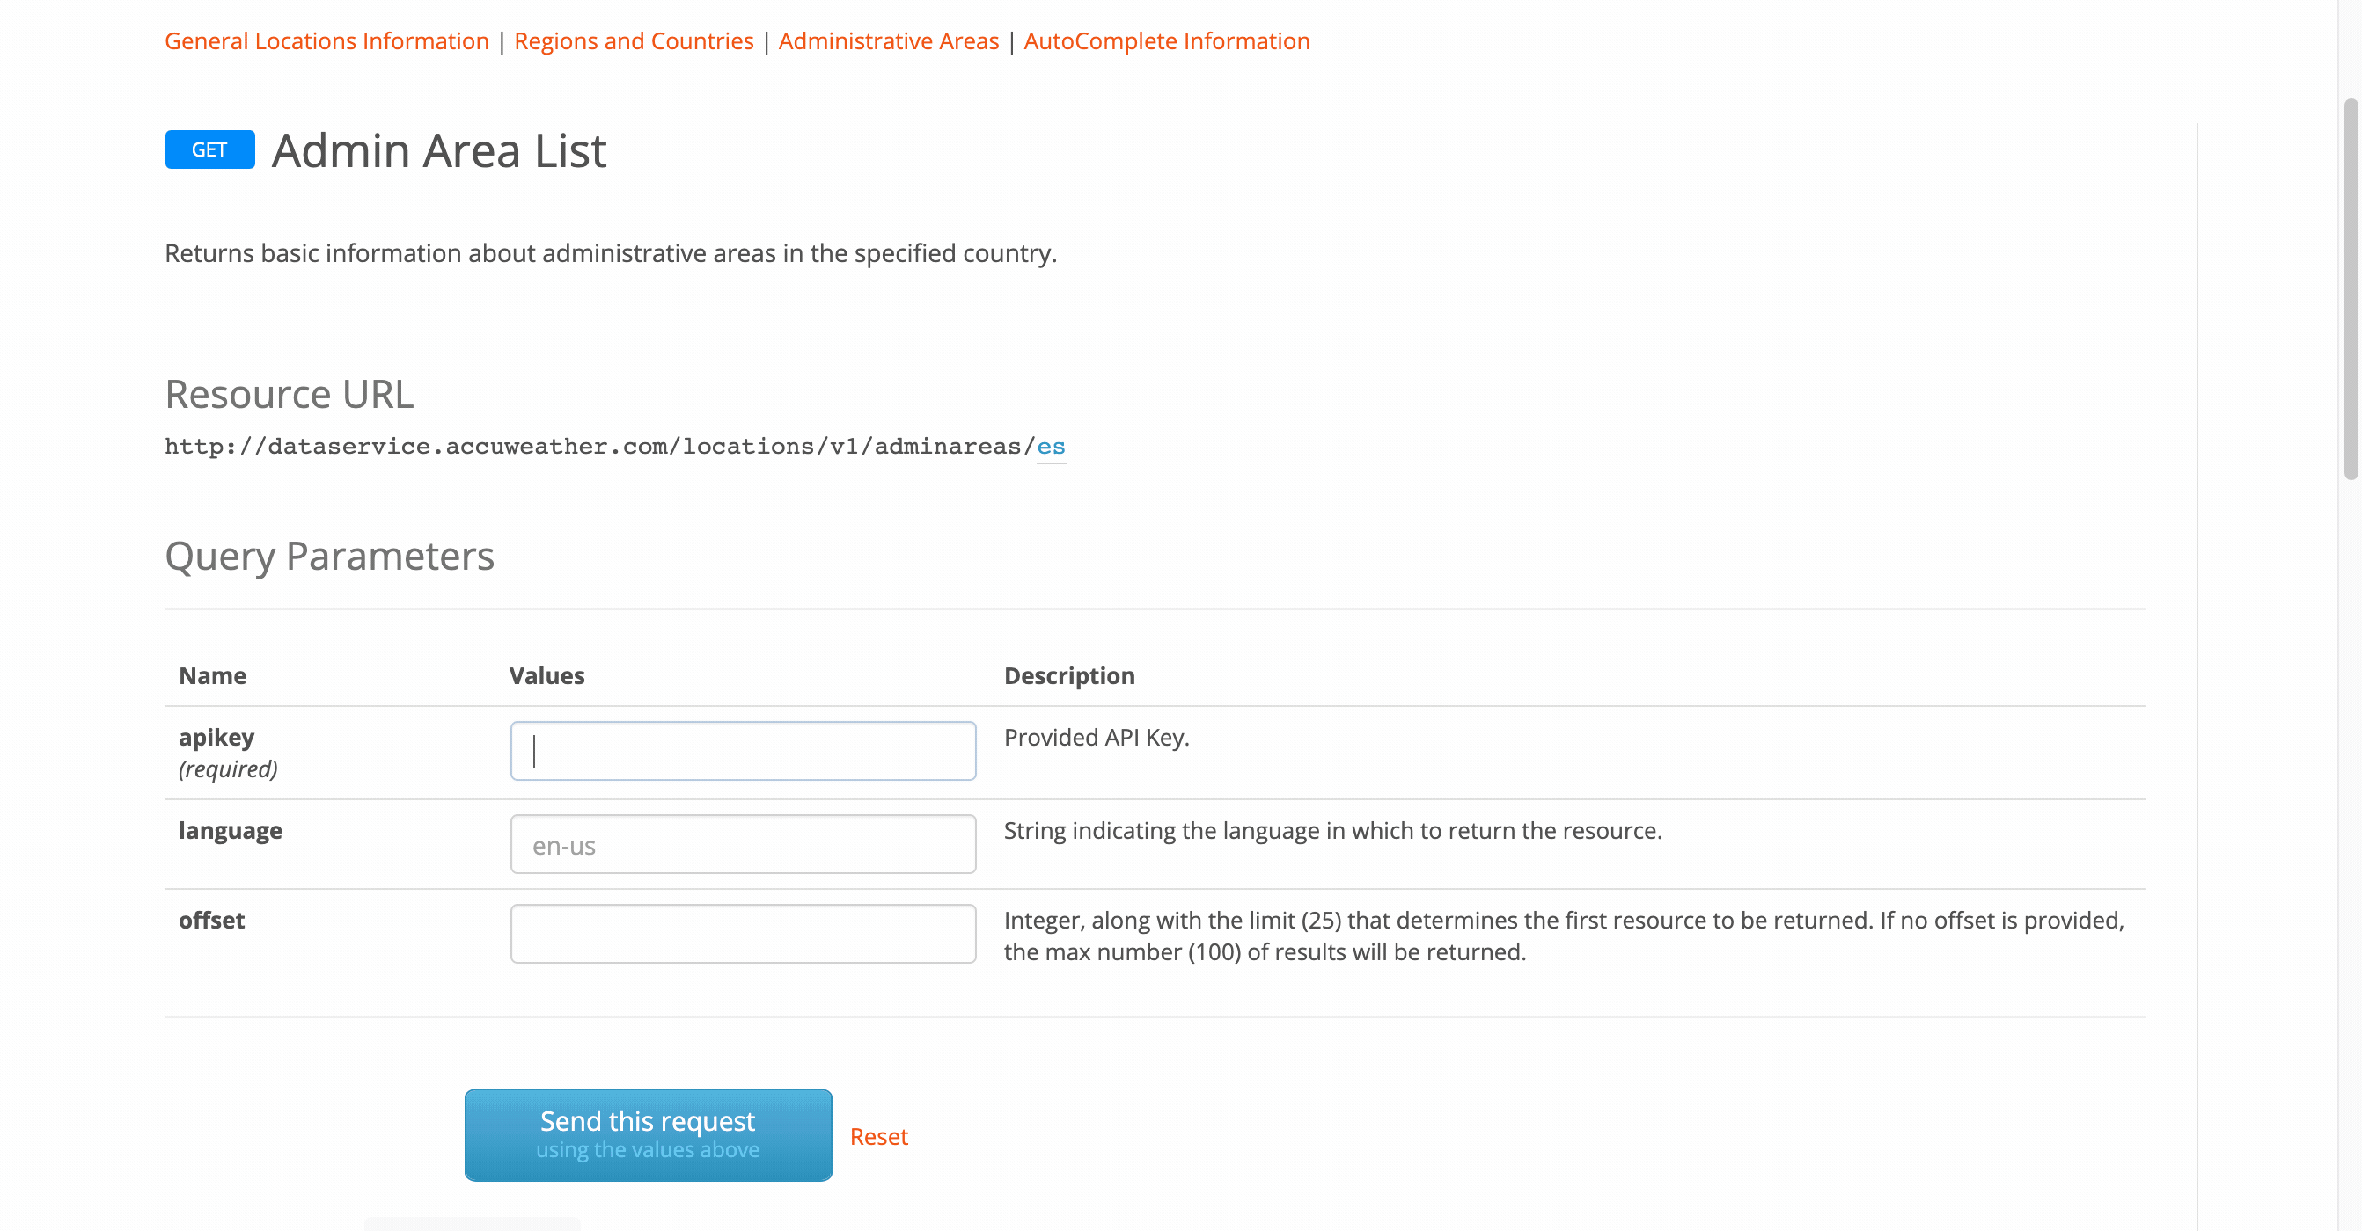
Example: AccuWeather Web API

Slide 4
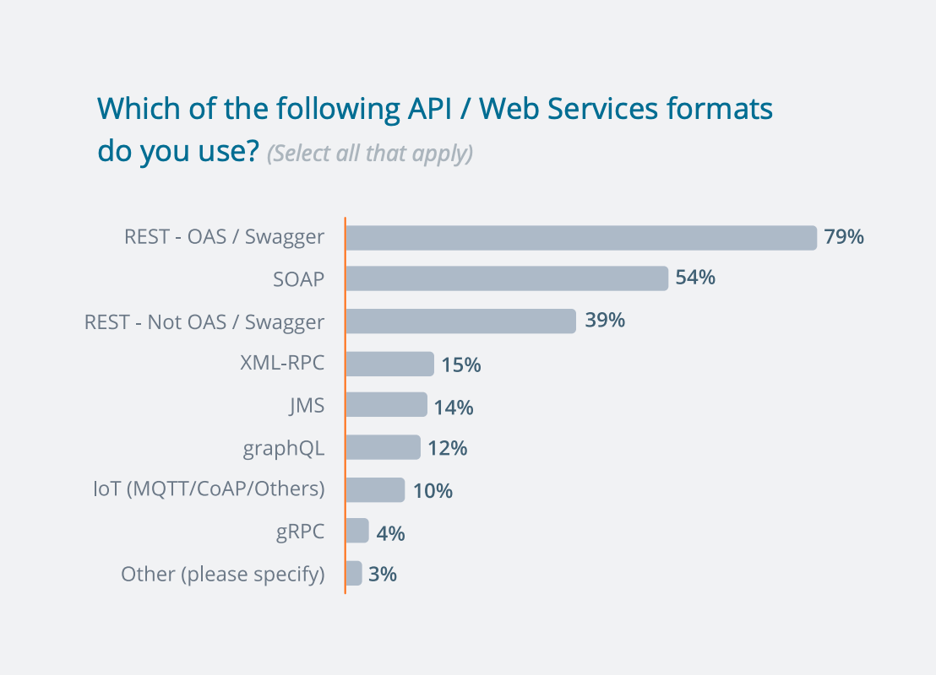
REST is king (for now)
https://smartbear.com/SmartBearBrand/media/pdf/SmartBear_State_of_API_2019.pdf

Slide 5


What is REST?
Representation State Transfer, a software architectural style. REST web services allow to access and manipulate resources by using a uniform, idempotent (HTTP), predefined set of stateless operations.
Stuff happening behind the scenes
GET /accounts
REST API
Client
Response (JSON, XML, etc.)
Data
https://en.wikipedia.org/wiki/Representational_state_transfer
Notes:
REST stands for representational state transfer, a software architectural style.
Resources are abstractions for data you access or manipulate. It can be documents, persons, accounts, or even likes on a page.
Instead of using arbitrary operations as in SOAP, REST web services can use a uniform set of HTTP operations and it’s stateless, meaning that the server remembers nothing about previous queries: every request is treated as new. “No client context shall be stored on the server between requests. The client is responsible for managing the state of the application.”
making multiple identical requests has the same effect as making a single request – then that REST API is called idempotent.

Slide 6
Resources are stuff, not what you do on stuff
A resource are objetcs you manipulate using the API, from data to states to attributes. But they can’t be actions!
✅ POST /pictures/1/metadata
🛑 POST /pictures/1/delete
Resources have identifiers (that’s why you usually pluralize the nouns)
Resources usually carry a data model
Technical writers have much to say about resource naming and styling
https://restfulapi.net/resource-naming/

Slide 7
Uniform set of operations: HTTP verbs
GET: Retrieve a resource or a list of resources
POST: Create a resource or a list of resources, or send data
PUT: Update a resource or a list of resources
PATCH: Partially update a resource or a list of resources
DELETE: Removes or disable a resource or a list of resources
All you’ll find are recommendations: actions can be implemented in a variety of non-standard ways – check with your engineering team!

Slide 8
Design is Documentation is Design
You should not limit yourself to the task of documenting the API
As an API technical writer, you’ve a complete view of the whole API
You can, and should, help the engineering team to decide:
Naming and formatting conventions for the API
Structure of the API
Style guide for summaries, examples, and descriptions
Text for the error codes
Examples
If nobody is in charge, take the helm
Recruit architects / lead engineers to deal with the most technical bits

Slide 9

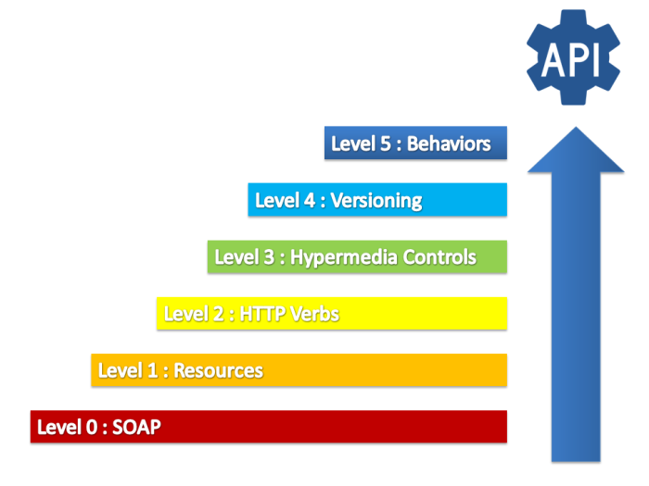
What is RESTful
GET /resources/1
https://damienfremont.com/2017/11/23/rest-api-maturity-levels-from-0-to-5/
/resources
/RetrieveAllShinyPinkResourcesThanks
Notes:
There’s degrees of REST. That’s why we say RESTful. An API can be more or less RESTful depending on how it implements the REST style. The more RESTful an API is, the more uniform, self-descriptive, and stateless it is.
At level 0, which is where we are right now with SOAP, we simply send arbitrary operations over HTTP. We use HTTP as a tunnel, and that’s it. Everything is hidden.
At level 1, we use resources, so there’s an URI per resource, like /user. But we could be using the same HTTP action for two different things, such as creating and deleting gusers.
At level 2, we use HTTP verbs, like GET, DELETE, PUT, etc. Actions are not in the URL, but in the HTTP method. There’s idempotence, meaning that actions can be applied multiple times without changing the result .
At level 3, the API is self-descriptive and can be navigated. Responses include links to dig deeper into the API. Level 4 includes versioning. Level 5 includes next actions!

Slide 10
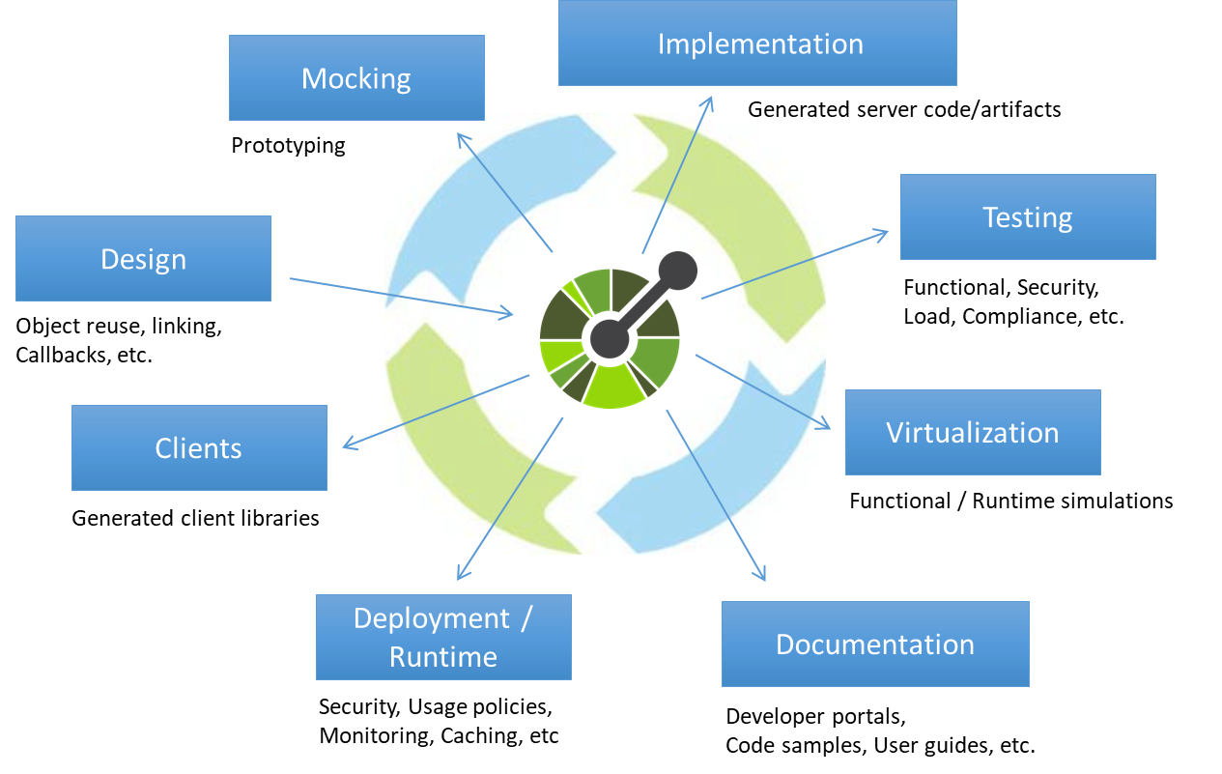
What is OpenAPI?
It’s a language-agnostic specification for describing, producing, consuming, and visualizing RESTful web services.
Notes:
OpenAPI is a specification format for describing RESTful APIs. It started as Swagger, but it’s now an open source project managed by the Linux Foundation.
The OpenAPI Specification (OAS) defines a standard, language-agnostic interface to RESTful APIs which allows both humans and computers to discover and understand the capabilities of the service without access to source code, documentation, or through network traffic inspection. When properly defined, a consumer can understand and interact with the remote service with a minimal amount of implementation logic.
An OpenAPI definition can then be used by documentation generation tools to display the API, code generation tools to generate servers and clients in various programming languages, testing tools, and many other use cases.
In OpenAPI you find this powerful idea that you can describe an API with a structured text file, and that that file can be used for multiple purposes, as the single source of truth on the API.
Serves as a contract between team members
Everyone collaborates on REST API design
One spec for testing, implementation, documentation…
Dependencies are removed (FE doesn’t wait for BE, etc.)
Allows to…
…generate interactive reference documentation (try out the API)
…generate code stubs/boilerplate for server-side logic
…create Node tests for the API using oatts

Slide 11
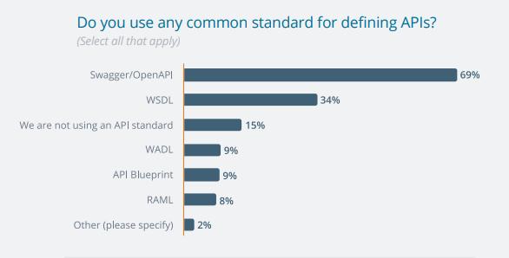
Why OpenAPI?
https://smartbear.com/SmartBearBrand/media/pdf/SmartBear_State_of_API_2019.pdf
Notes:
OpenAPI is the most popular API design and specification standard according to the State of the API survey 2019.
Using OpenAPI means having
Not using a standard for defining an API is a bad choice. But then again, why OpenAPI?

Slide 12
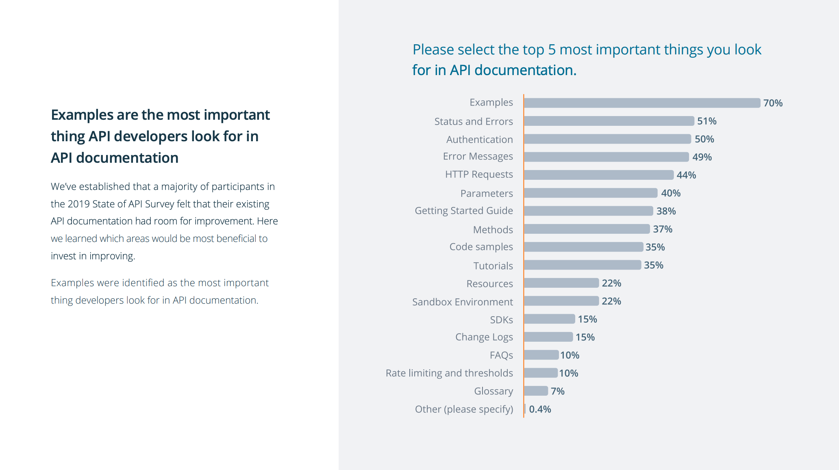
API Reference documentation is key
https://smartbear.com/SmartBearBrand/media/pdf/SmartBear_State_of_API_2019.pdf

Slide 13
Generating API Reference docs from OpenAPI
SwaggerHub (and Swagger UI)
ReDoc
Widdershins
Readme.com (Saas)
Stoplight Docs (Saas)

Slide 14
Dive into OpenAPI
Why is it so dark in here?

Slide 15

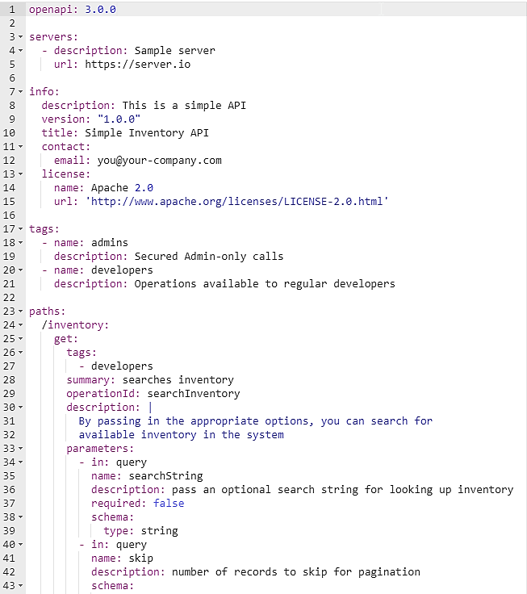
OpenAPI 3
JSON or YAML format
Can be written using any text or code editor
Can contain extensions (custom fields)
Supports CommonMark in description fields
Names are case sensitive (cuteDog != cutedog)
Allows external references ($ref) to reuse definitions or split large specifications
https://swagger.io/specification/
Notes:
This is how a typical OpenAPI 3.0 file looks like. It can be in either JSON or YAML formats…

Slide 16
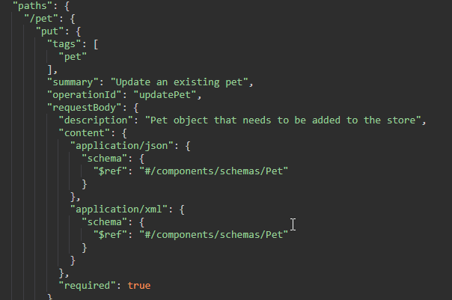
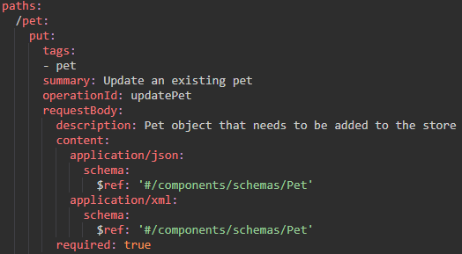
JSON or YAML?
Curly braces or whitespaces?
JSON
YAML
Notes:
OpenAPI specification files can be written in JSON or YAML.
My choice is to go with YAML. It’s a superset of JSON, and it’s way easier to write and read. You can insert JSON into YAML but not viceversa. You can also convert between the two of them.

Slide 17
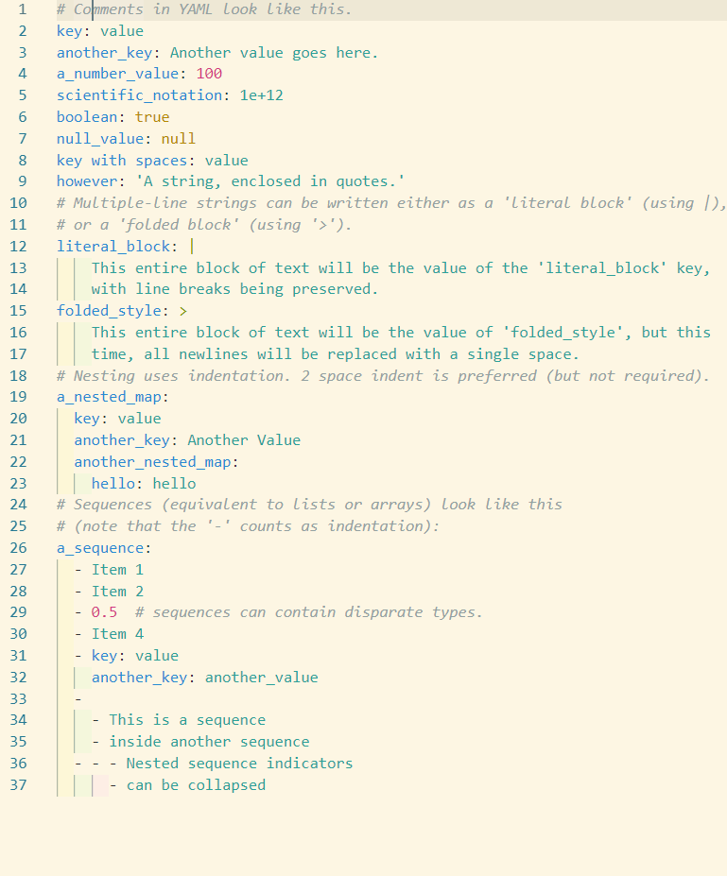
YAML Basics
Two-space indent to nest objects
No need for quotes or braces
Hyphens for arrays (sequences)
Arrays (sequences) can be nested
https://learnxinyminutes.com/docs/yaml/

Slide 18
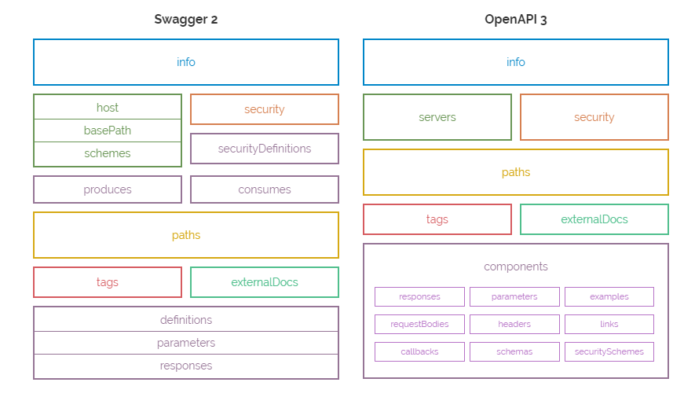
Swagger 2 or OpenAPI 3?
https://blog.readme.io/an-example-filled-guide-to-swagger-3-2/
Notes:
First tough question: Swagger 2.0 or OpenAPI 3.0?
Well, OpenAPI 3.0 is the future, has a simpler, better structure, and better support for the JSON schema. It supports links, callbacks, and other cool features.
Swagger is still the name of the tools, so it can be a bit confusing.

Slide 19
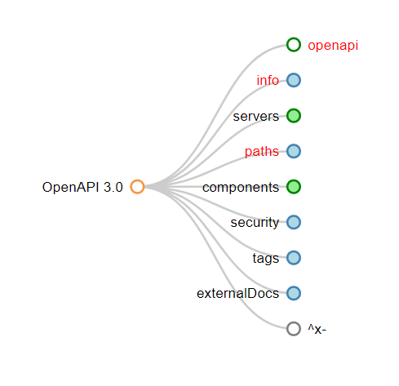
OpenAPI Structure

Slide 20
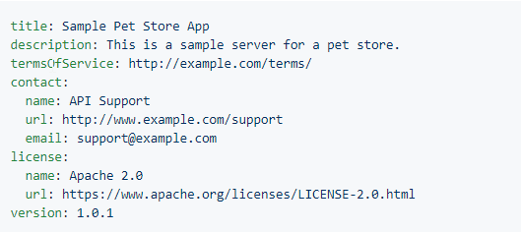
Info object
https://github.com/OAI/OpenAPI-Specification/blob/master/versions/3.0.2.md

Slide 21
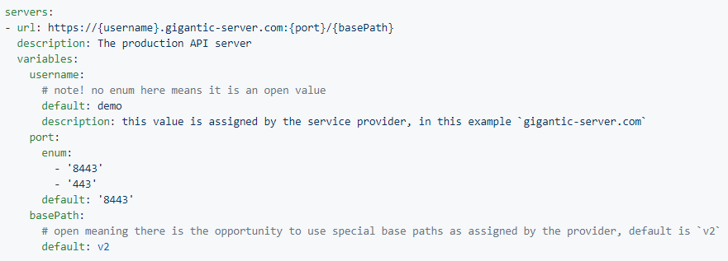
Servers object
https://github.com/OAI/OpenAPI-Specification/blob/master/versions/3.0.2.md

Slide 22
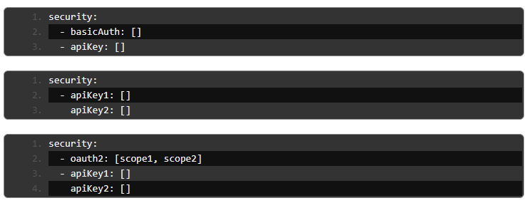
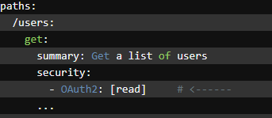
Security object
https://swagger.io/docs/specification/authentication/
Notes:
Security schemes are added at API level through the security object.
They can be combined in several ways. In the first example, either basicAuth or apiKey can be used, while in the second it’s apiKey1 AND apiKey2. In the third, it’s OAUTH2 or the combination of two apiKeys.
Security can be defined at path / method level, which overrides global settings.

Slide 23
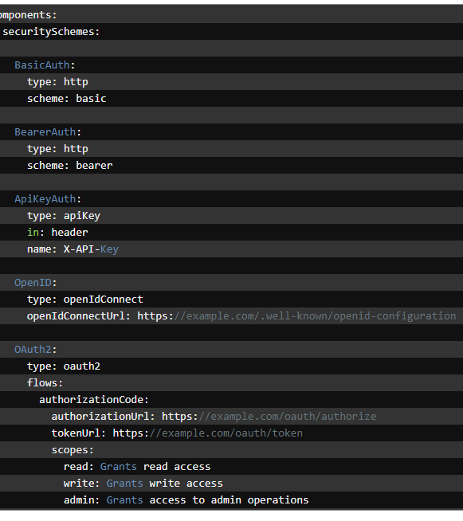
Security schemes
HTTP Authentication
Basic
Bearer
API keys
Cookies
OAuth 2
OpenID

Slide 24

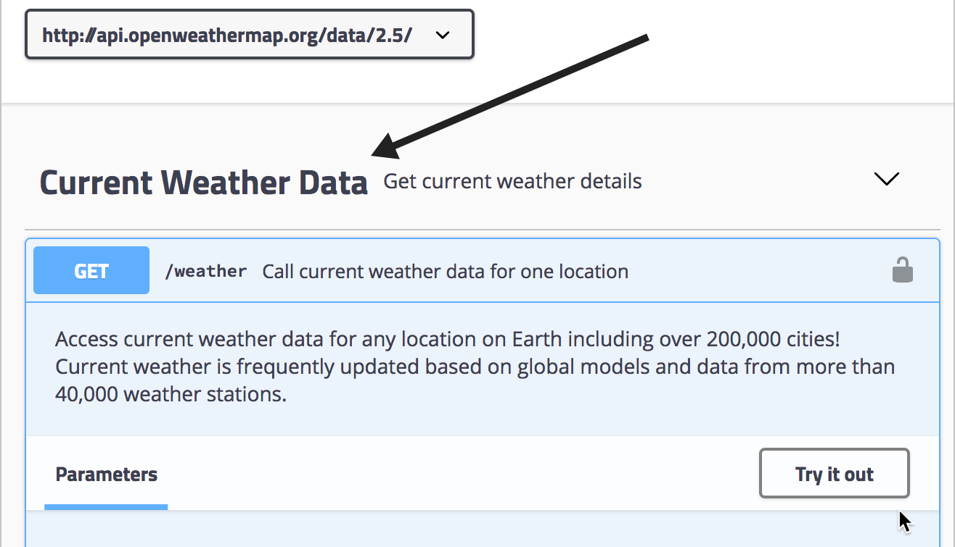
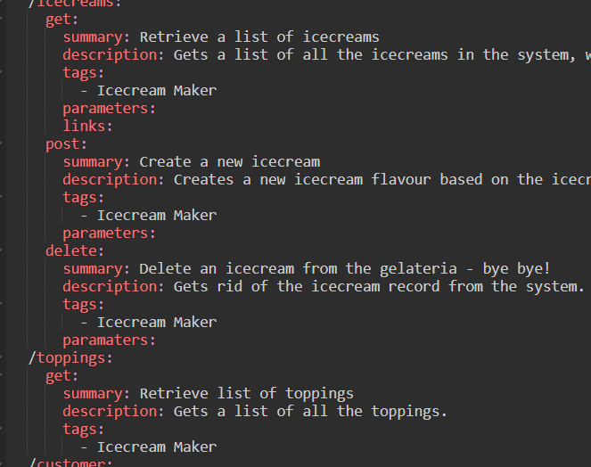
Tags object
Used to organize paths together in docs and UIs
Useful when you have lots of endpoints

Slide 25
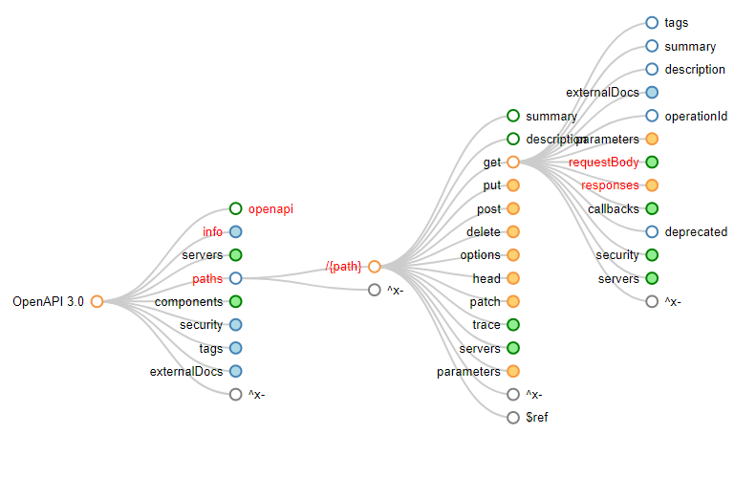
Path object
https://github.com/OAI/OpenAPI-Specification/blob/master/versions/3.0.2.md
Notes:
The PATH object contains the meat of the whole specification. It’s where you’ll spend the most time designing and documenting the API.
The path object is composed of /paths, followed by HTTP operations that contain information such as request parameters/body, responses, etc.
Since OpenAPI 3.0, paths can be deprecated.

Slide 26
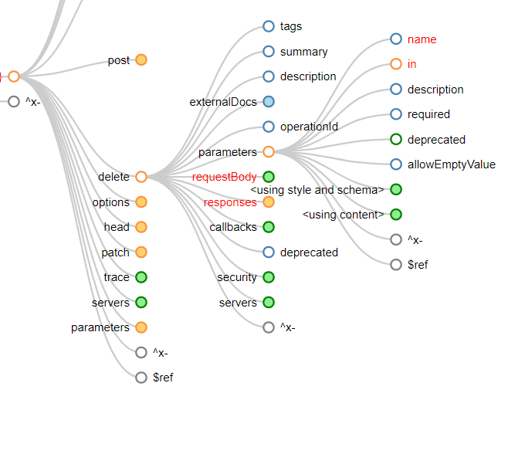
Parameters
path parameters, such as /users/{id}
query parameters, such as /users?role=admin
header parameters, such as X-MyHeader: Value
cookie parameters
default values can be set in non-required params
Empty parameters: allowEmptyValue: true
Nullable? Use nullable: true
Constant parameters are allowed as well
Predefined values can be defined using enum:
Parameters shared by all operations of a path can be defined on the path level instead of the operation level. Path-level parameters are inherited by all operations of that path and can be overridden.
Notes:
Path parameters are variable parts of a URL path. The parameter name must be the same as specified in the path. Also remember to add required: true, because path parameters are always required.
Query parameters go in the URL. To describe API keys passed as query parameters, use securitySchemes and security instead. With allowReserved: true you can avoid the typical percent-encoded URLs.
Header parameters go in the header of the HTTP request. Header parameters named Accept, Content-Type and Authorization are not allowed. To describe these headers, use the corresponding OpenAPI keywords.
OpenAPI 3.0 does not support parameter dependencies and mutually exclusive parameters. There is an open feature request at https://github.com/OAI/OpenAPI-Specification/issues/256.

Slide 27
Let’s go to the pet store
https://github.com/OAI/OpenAPI-Specification/blob/master/examples/v3.0/petstore.yaml

Slide 28
Parameter serialization
Serialization is translating data into a format that can be transmitted and reconstructed later
Operation parameters support serialization for path, query, header, and cookie
Default settings are OK for most cases, but can be overridden using style and explode
Default values
In | Style | Explode | URI template | Array example
path | simple | false | /users/{id} | /users/3,4,5
query | form | true | /users{?id*} | /users?id=3&id=4&id=5
header | simple | false | {id} | X-MyHeader: 3,4,5
cookie | form | true
https://swagger.io/docs/specification/serialization

Slide 29
Data types
Type | Format | Attributes
number / integer | float, double int32, int64 | minimum, maximum (number) exclusiveMinimum, exclusiveMaximum (bool) multipleOf (number)
string | date, date-time, password, byte, binary (files) email, uuid, uri… | minLength, maxLength (number) pattern (regex!)
boolean
array | - items: of other types, including objects | minItems, maxItems (number) uniqueItems (bool)
objects | - properties: | required (bool) readOnly, writeOnly (bool)
null (nullable:)
https://github.com/OAI/OpenAPI-Specification/blob/master/versions/3.0.2.md
Notes:
You can use uniqueItems: true to specify that all items in the array must be unique:
An object is a collection of property/value pairs. The properties keyword is used to define the object properties – you need to list the property names and specify a schema for each property. An object can include nested objects
Tip: In OpenAPI, objects are usually defined in the global components/schemas section rather than inline in the request and response definitions. A schema without a type matches any data type – numbers, strings, objects, and so on. {} is shorthand syntax for an arbitrary-type schema:

Slide 30
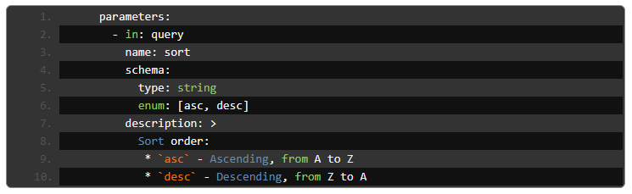
Enum
Enums can be used to specify acceptable values of a request or a model property
https://swagger.io/docs/specification/data-models/enums/

Slide 31
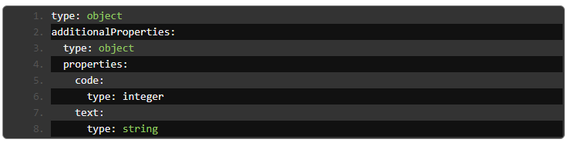
Dictionaries, hashmaps, and associative arrays
A dictionary (also known as a map, hashmap or associative array) is a set of key/value pairs. OpenAPI lets you define dictionaries where the keys are strings.
To define a dictionary, use type: object and use the additionalProperties keyword to specify the type of values in key/value pairs.
If the dictionary values can be of any type (aka free-form object), use additionalProperties: true
https://swagger.io/docs/specification/data-models/dictionaries/

Slide 32
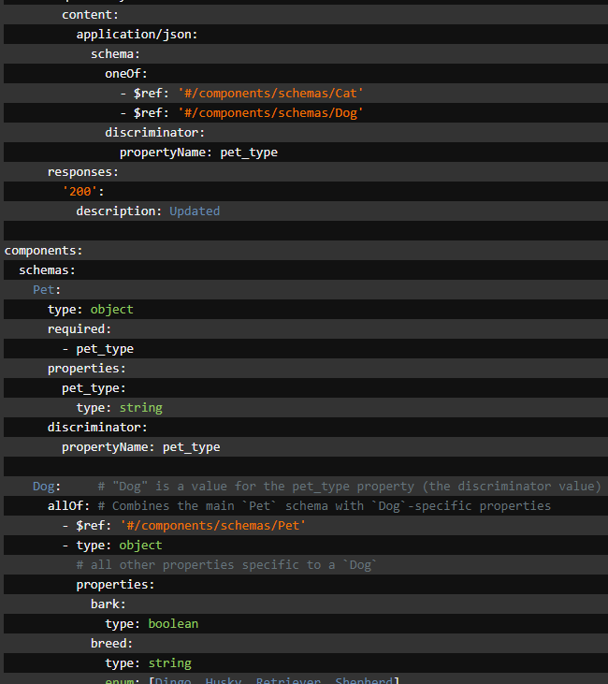
one of, anyof, allof, not
oneOf – validates the value against exactly one of the subschemas
allOf – validates the value against all the subschemas
anyOf – validates the value against any (one or more) of the subschemas
not – make sure value is not valid against the specified schema
Inheritance: allOf
Polymorphism: anyOf / oneOf
https://swagger.io/docs/specification/data-models/oneof-anyof-allof-not/
https://swagger.io/docs/specification/data-models/inheritance-and-polymorphism/
Notes:
OpenAPI 3.0 provides several keywords which you can use to combine schemas. You can use these keywords to create a complex schema, or validate a value against multiple criteria.
Use the anyOf keyword to validate the data against any amount of the given subschemas. That is, the data may be valid against one or more subschemas at the same time.
The not keyword does not exactly combine schemas, but as all of the keywords mentioned above it helps you to modify your schemas and make them more specific.
When request bodies or response payloads may be one of a number of different schemas, a discriminator object can be used to aid in serialization, deserialization, and validation. The discriminator is a specific object in a schema which is used to inform the consumer of the specification of an alternative schema based on the value associated with it.

Slide 33
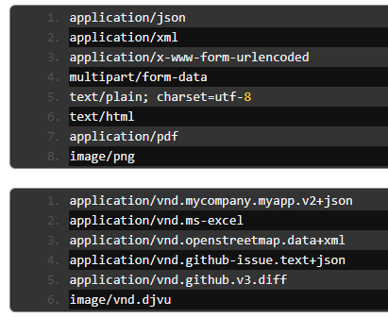
Media types
Media type declarations go within the content object
They have a schema and can have several examples
Vendor-specific types are indicated by .vnd
Wildcards can be used (for example, image/*)
https://github.com/OAI/OpenAPI-Specification/blob/master/versions/3.0.2.md

Slide 34
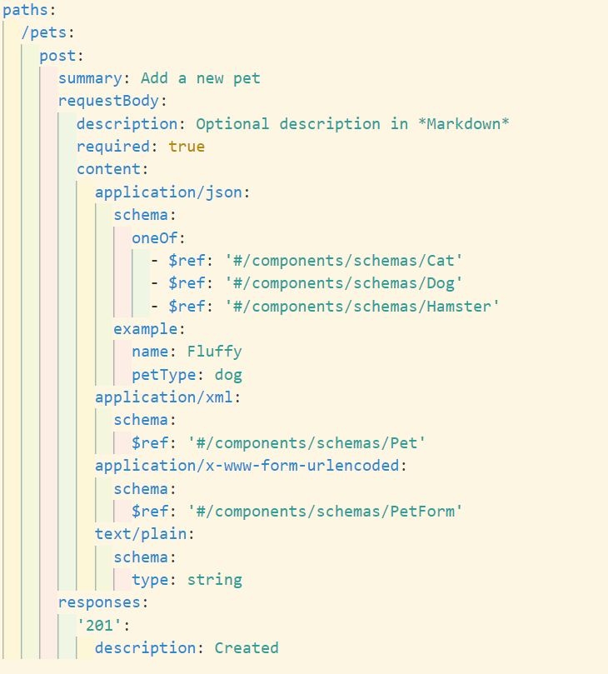
Request body
POST, PUT, PATCH can have request bodies
Optional by default, but can set to required: true
Admits summary, description, and examples
Can link to reusable bodies ($ref)
File uploads can be specified via media type + format: binary or format: base64
multipart/form-data allows to send files alongside other data
https://swagger.io/docs/specification/describing-request-body/

Slide 35
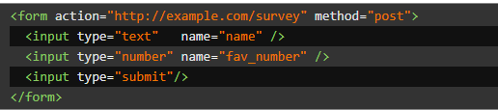
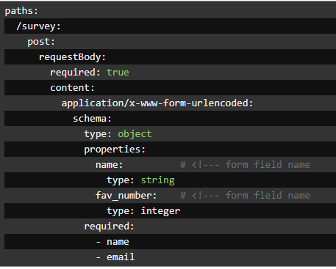
Form data
application/x-www-form-urlencoded
ASCII key=value pairs
multipart/form-data
Multiple media types (image, text, etc.)
Notes:
The term “form data” is used for the media types application/x-www-form-urlencoded and multipart/form-data, which are commonly used to submit HTML forms.

Slide 36
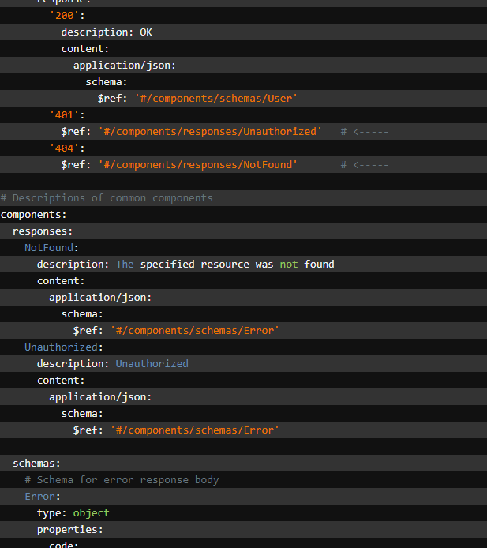
Responses
Each operation must have at least one response
Responses are defined by HTTP status codes
Response data is defined as primitives or objects
default: can be used to describe HTTP codes that are not covered individually for an operation (for instance, all undescribed error codes)
Responses can be reused by defining them under components
https://swagger.io/docs/specification/describing-responses/

Slide 37
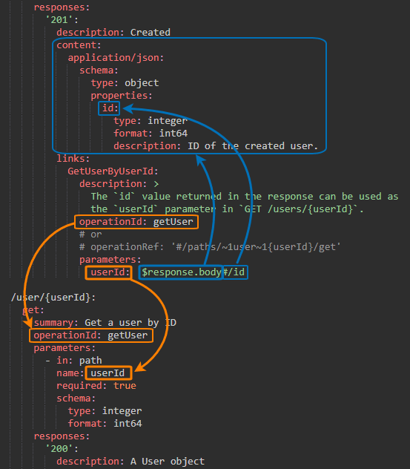
Links
Provide next actions in responses
Enable self-documented APIs
Added at responses: level
operationId: ID of the path element
operationRef: when ID is not available
parameters / requestBody: what parameters or request body are relayed to the target operation
Strings containing embedded runtime expressions or hardcoded values can be used as well:
ID_{$response.body#/id}
start_date: ‘’
https://swagger.io/docs/specification/links/
Notes:
Links are one of the new features of OpenAPI 3.0. Using links, you can describe how various values returned by one operation can be used as input for other operations. It allows an API to be more self-descriptive.

Slide 38
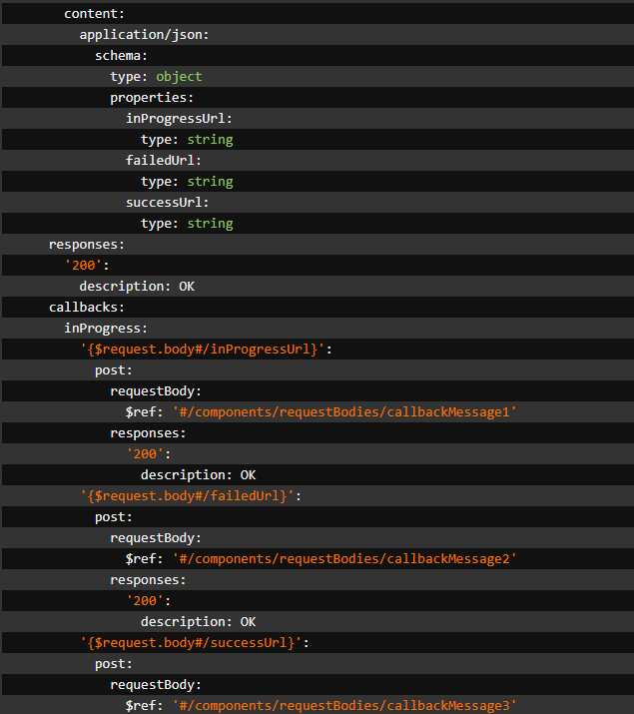
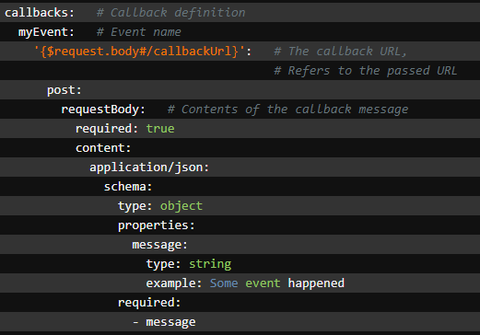
Callbacks
Used for webhooks and subscription mechanisms
Multiple callbacks can be defined
https://swagger.io/docs/specification/callbacks/
Notes:
In OpenAPI 3 specs, you can define callbacks – asynchronous, out-of-band requests that your service will send to some other service in response to certain events. This helps you improve the workflow your API offers to clients. A typical example of a callback is subscription functionality – users subscribe to certain events of your service and receive a notification when this or that event occurs. For example, an e-shop can send a notification to the manager on each purchase. These notifications will be “out-of-band”, that is, they will go through a connection other than the connection through which a visitor works, and they will be asynchronous, as they will be out of the regular request-response flow. In OpenAPI 3, you can define the format of the “subscription” operation as well as the format of callback messages and expected responses to these messages. This description will simplify communication between different servers and will help you standardize the use of webhooks in your API.
The way you implement the unsubscription mechanism is up to you. For example, the receiving server can return specific code in response to the callback message to indicate that it is no longer interested in callbacks. In this case, clients can unsubscribe only in response to a callback request. To allow clients to unsubscribe at any time, your API can provide a special “unsubscribe” operation. This is a rather common approach.

Slide 39
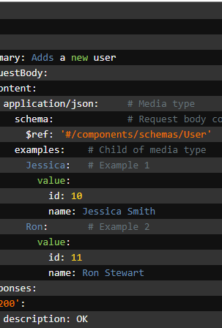
Examples
Part of the reference documentation
Can be added to parameters, properties, and objects
They can be used to simulate the API behavior
NOT the same as default values

Slide 40
Runtime expressions
Expression | Description
$url | The full request URL, including the query string.
$method | Request HTTP method, such as GET or POST.
$request.query.param_name | The value of the specified query parameter. The parameter must be defined in the operation’s parameters section, otherwise, it cannot be evaluated. Parameter names are case sensitive.
$request.path.param_name | The value of the specified path parameter. The parameter must be defined in the operation’s parameters section, otherwise, it cannot be evaluated. Parameter names are case sensitive.
$request.header.header_name | The value of the specified request header. This header must be defined in the operation’s parameters section, otherwise, it cannot be evaluated. Header names are case insensitive.
$request.body | The entire request body.
$request.body#/foo/bar | A portion of the request body specified by a JSON Pointer.
$statusCode | HTTP status code of the response. For example, 200 or 404.
$response.header.header_name | The complete value of the specified response header, as a string. Header names are case-insensitive. The header does not need to be defined in the response’s headers section.
$response.body | The entire response body.
$response.body#/foo/bar | A portion of the request body specified by a JSON Pointer.
foo{$request.path.id}bar | Enclose an expression into {} curly braces to embed it into a string.
Notes:
OpenAPI runtime expressions are syntax for extracting various values from an operation’s request and response. Links use runtime expressions to specify the parameter values to be passed to the linked operation. The expressions are called “runtime” because the values are extracted from the actual request and response of the API call and not, say, the example valuesprovided in the API specification.

Slide 41
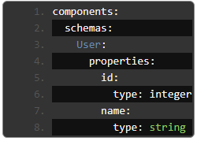
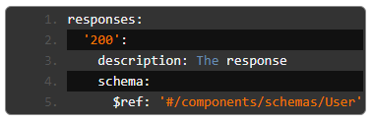
$REF and component reuse
$ref keyword allows to reuse a definition (so that you type less!)
Links to the path of the object (can be local, remote, or an URL)
$ref: '#/definitions/myElement’
$ref: '../document.json#/myElement’
$ref: 'http://path/to/your/resource.json#myElement'
https://swagger.io/docs/specification/using-ref/

Slide 42
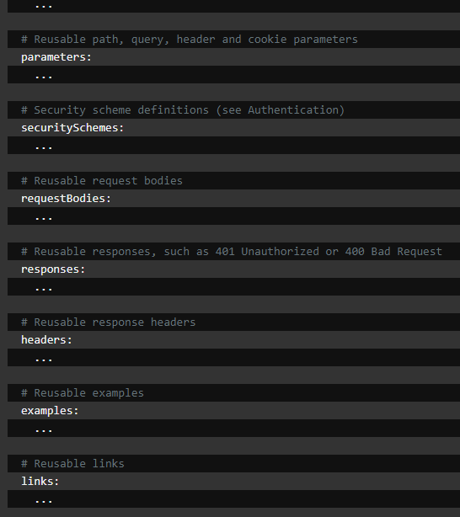
Components object
Serves as a container of various reusable definitions, parameters, examples, etc.
Only used when $referenced
Components can act as aliases for external definitions

Slide 43
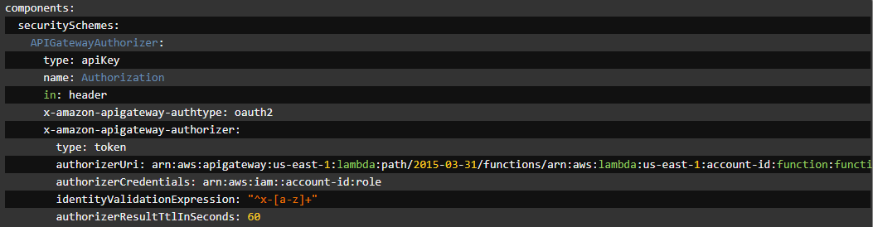
Extensions
https://swagger.io/docs/specification/openapi-extensions/
Notes:
Extensions, or vendor extensions, are custom properties that start with x-, such as x-logo. They can be used to describe extra functionality that is not covered by the standard OpenAPI Specification.

Slide 44

Useful resources
Beyond NOTEPAD.EXE

Slide 45

Most Frequent mistakes (OPENAPI + YAML)
Not indenting properly: not enough spaces, nesting inside the wrong object
Typos: bad paths, names, etc. Names in YAML are case sensitive, too
Using hyphen notation (array) when not needed—writing lists is so tempting
Not escaping strings (for instance description: This is the item: oh hello breaks due to the colon)
Forgetting about colons and slashes, especially in path objects (#components or /users{id})
Using required as a property attribute instead of object-level list
Using wrong data types and keywords
Keywords without a value
Forgetting about keywords (for instance, not adding type to properties)
Using default with required parameters/properties
Forgetting about components—you’ll regret that in the long run

Slide 46
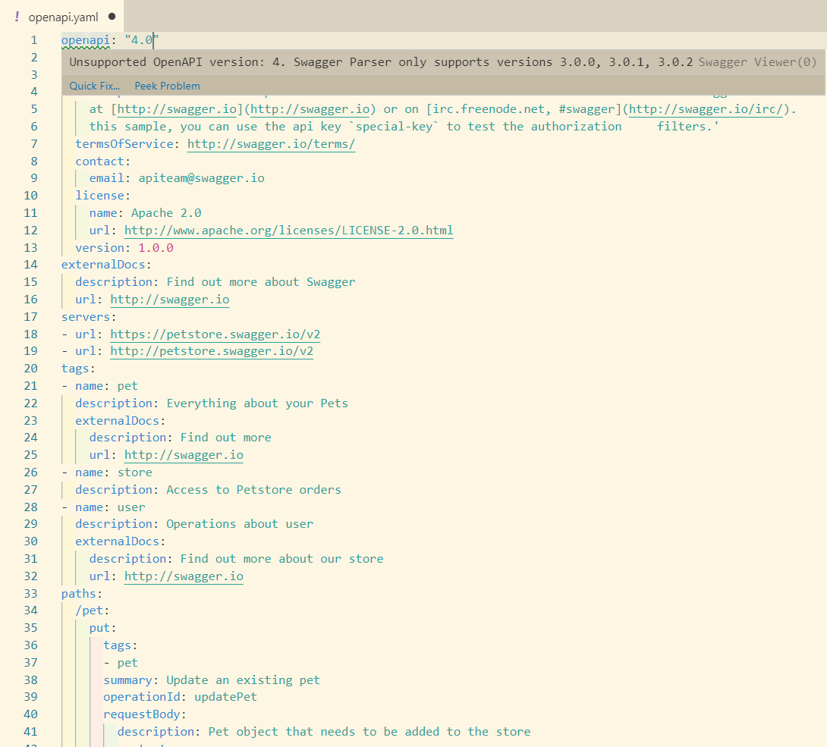
Validate your specs!
Speccy - https://speccy.io/
speccy lint openapi.yaml
OpenAPI Lint for VS Code
SwaggerHub Editor

Slide 47
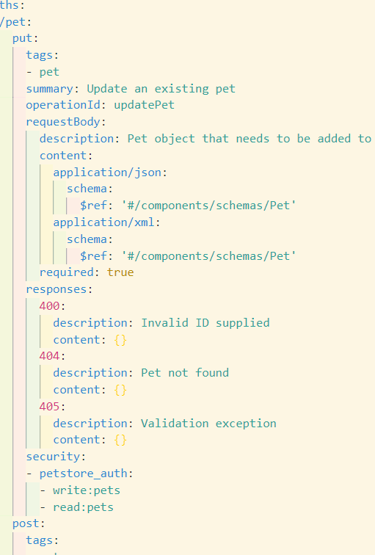
Useful VS CODE EXTENSIONS
Bracket Pair Colorizer 2 (for JSON)
Indent Rainbow (for YAML)
OpenAPI Lint
Swagger Viewer
YAML

Slide 48
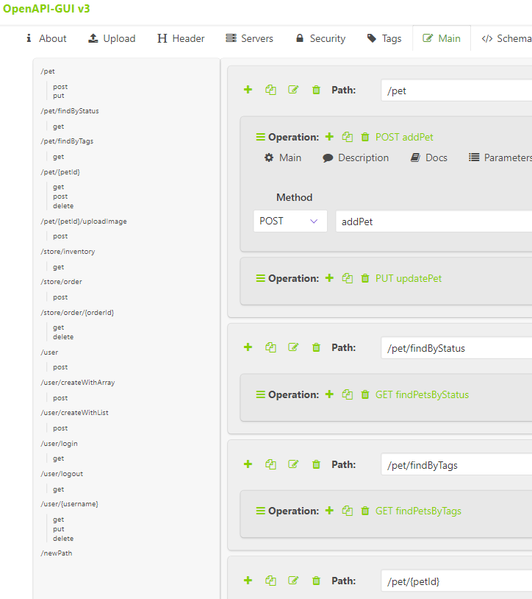
Useful websites
https://mermade.github.io/openapi-gui/
https://editor.swagger.io/
https://openapi-map.apihandyman.io/
https://openapi.tools/
https://opensource.zalando.com/restful-api-guidelines/
https://github.com/APIs-guru/openapi-directory
https://idratherbewriting.com/learnapidoc/

Slide 49
Exercise!
Time to write a simple OpenAPI 3.0 Specification

Slide 50
Improve the Gelato API
The Gelato API lets everyone get data on ice creams and toppings. With proper authentication, users can also add ice creams, toppings, and customers. Let’s improve it!
Open Swagger Editor and load the gelato.yaml file from here: http://bit.do/gelatoapi
Add contact information to the info object
Add the gelatoKey security to the POST operations
Define the topping schema in components (toppings need to have an id)
Add a DELETE operation to get rid of a topping via its id (don’t forget to tag it and add security)
Add the person object properties to the customer object via inheritance
Complete the POST operation to add a new customer (hint: it needs request data)
Check that the specification is valid and generate .NET server code from the specification
Notes:
allOf: - $ref: "#/components/schemas/person"

